Slide 1
Maths Curriculum Evening
27th November 2023

Slide 2
What does the National Curriculum say?
The curriculum aims that all children:
become fluent in the fundamentals of mathematics, including through varied and frequent practice with increasingly complex problems over time, so that pupils develop conceptual understanding and the ability to recall and apply knowledge rapidly and accurately.
can reason mathematically by following a line of enquiry, conjecturing relationships and generalisations, and developing an argument, justification or proof using mathematical language.
can solve problems by applying their mathematics to a variety of routine and non-routine problems with increasing sophistication, including breaking down problems into a series of simpler steps and persevering in seeking solutions.

Slide 3
What is maths mastery?
Achievable for all
Deep and sustainable learning
The ability to build on something which has already been sufficiently mastered
The ability to reason about a problem and make connections
Conceptual and procedural fluency
Our aim is for all children to achieve mastery in maths
It is not about giving different tasks, more questions or bigger numbers to work with
Children’s knowledge is stretched and deepened through careful questioning and their ability to prove, explain and represent their understanding in different ways

Slide 4



Schemes we use
White Rose Education (whole school)
Mastering Number (EYFS and KS1)
We also make use of the nrich website for developing investigation skills.

Slide 5
Mastering Number
Mastering Number at Reception and KS1 | NCETM
Started this year in Oak and Chestnut classes
10 minute sessions in addition to daily maths lessons
Aim to improve children’s flexibility of number, mental maths and number confidence
Separate sessions for Reception, Year 1 and Year 2
An example activity from Reception and Year 2

Slide 6
Mastering Number 2021/22 ncetm.org.uk

Slide 7
Mastering Number 2021/22 ncetm.org.uk

Slide 8
Mastering Number 2021/22 ncetm.org.uk

Slide 9
Mastering Number 2021/22 ncetm.org.uk

Slide 10
Mastering Number 2021/22 ncetm.org.uk

Slide 11
Mastering Number 2021/22 ncetm.org.uk

Slide 12
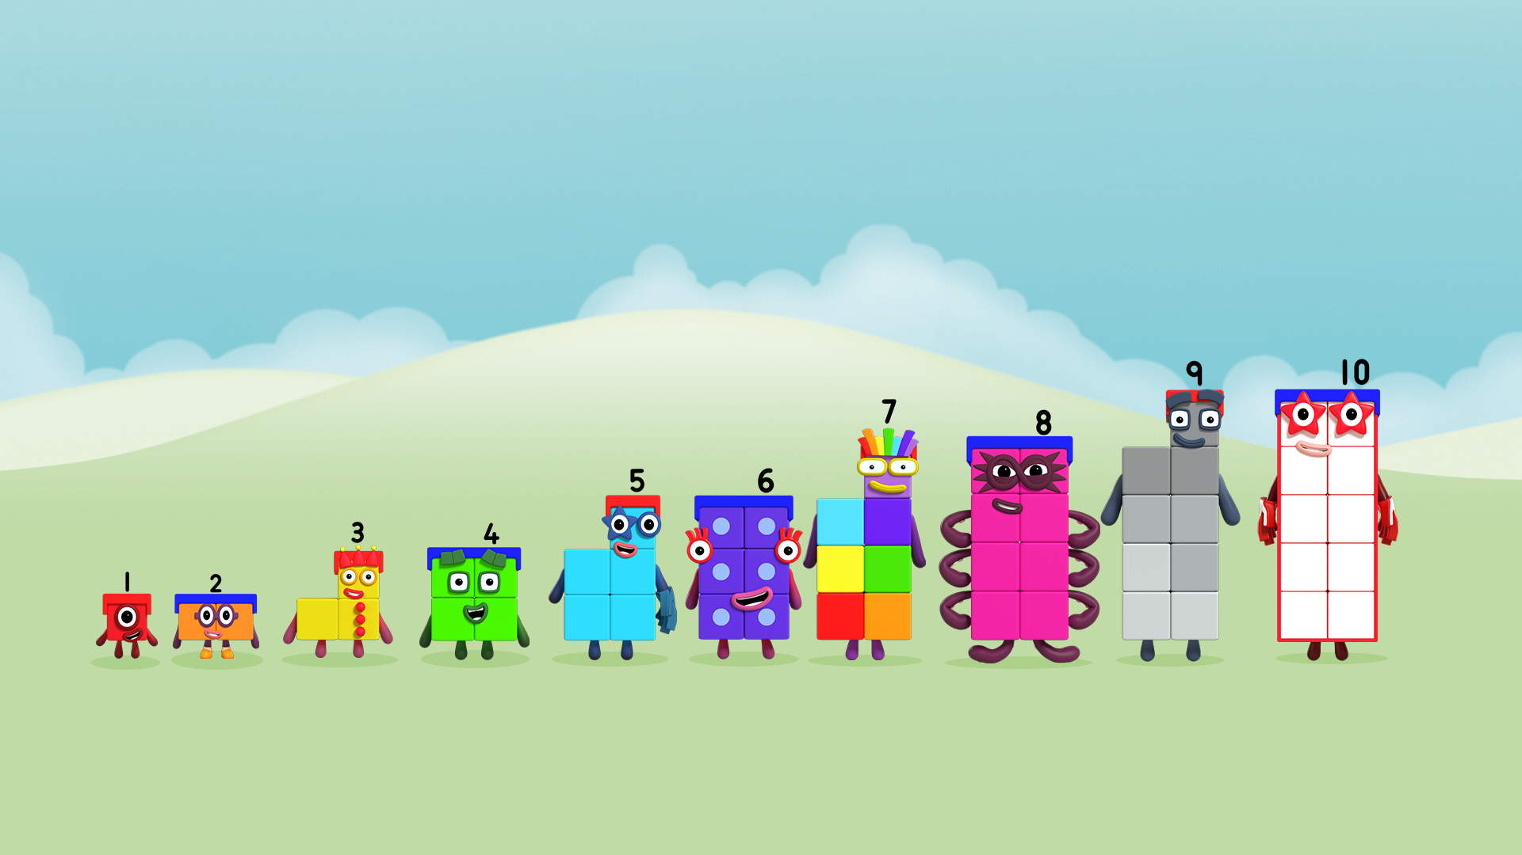
Guess which number we will be looking at…
The odd-tops!
Image © 2021 Alphablocks Ltd. All rights reserved. Mastering Number 2021/22 ncetm.org.uk

Slide 13
Describe where 7 is on a number line in relation to 5 and 10.
0
1
2
3
4
5
6
7
8
9
10
Mastering Number 2021/22 ncetm.org.uk

Slide 14
Think about 7 on the double dice frame and the rekenrek.
What’s the same? What’s different?
Mastering Number 2021/22 ncetm.org.uk

Slide 15
Use your rekenrek to make the number shown. Then make 7.
_____ needs _____ to make 7;
_____ and _____ make 7.
Mastering Number 2021/22 ncetm.org.uk

Slide 16
_____ needs _____ to make 7;
_____ and _____ make 7.
Mastering Number 2021/22 ncetm.org.uk

Slide 17
_____ needs _____ to make 7;
_____ and _____ make 7.
Mastering Number 2021/22 ncetm.org.uk

Slide 18
_____ needs _____ to make 7;
_____ and _____ make 7.
Mastering Number 2021/22 ncetm.org.uk

Slide 19
_____ needs _____ to make 7;
_____ and _____ make 7.
Mastering Number 2021/22 ncetm.org.uk

Slide 20
_____ needs _____ to make 7;
_____ and _____ make 7.
Mastering Number 2021/22 ncetm.org.uk

Slide 21
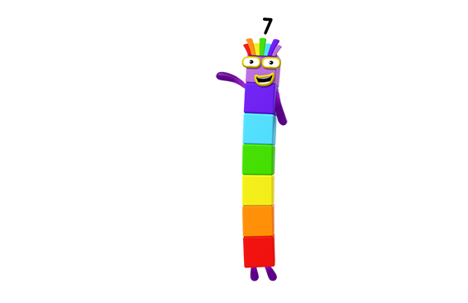
6 + 1
Can you see if I am made of odd or even numbers?
5 + 2
4 + 3
3 + 4
2 + 5
1 + 6
Image © 2021 Alphablocks Ltd. All rights reserved. Mastering Number 2021/22 ncetm.org.uk

Slide 22
White Rose Education
Advice and guidance for parents | White Rose Maths (whiteroseeducation.com)
Used from Reception to Year 6
Sequenced carefully to ensure progression within and across units
Separate planning and teaching for each year group – each year group has their own lesson
All children in a year group access the same teaching content and follow-up activities
Our calculation policies are based on the White Rose scheme (Addition and Subtraction, Multiplication and Division)

Slide 23
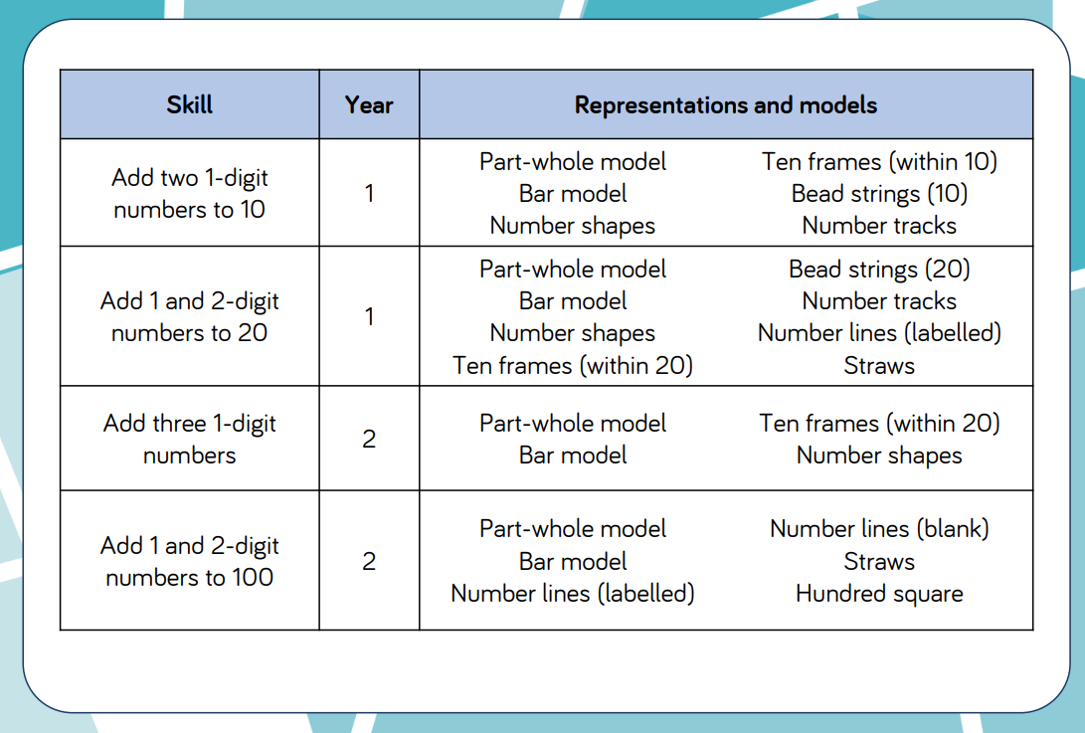
Calculation policy – Addition

Slide 24
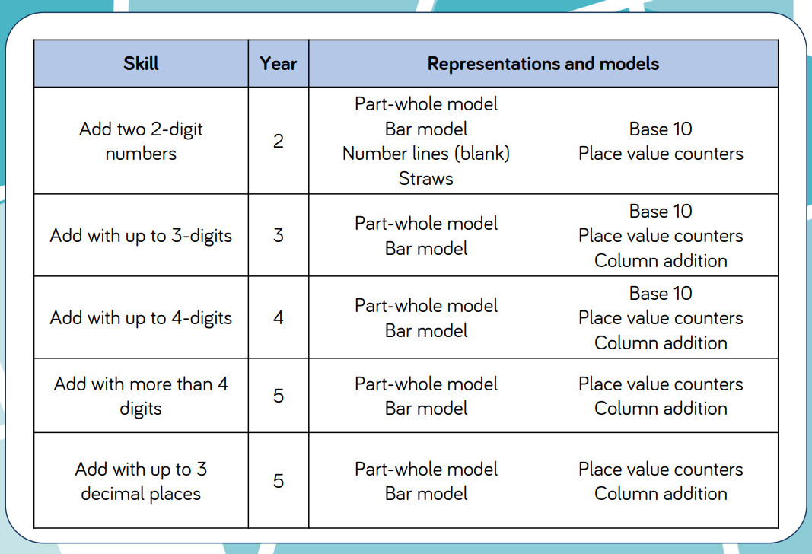
Calculation policy – Addition

Slide 25
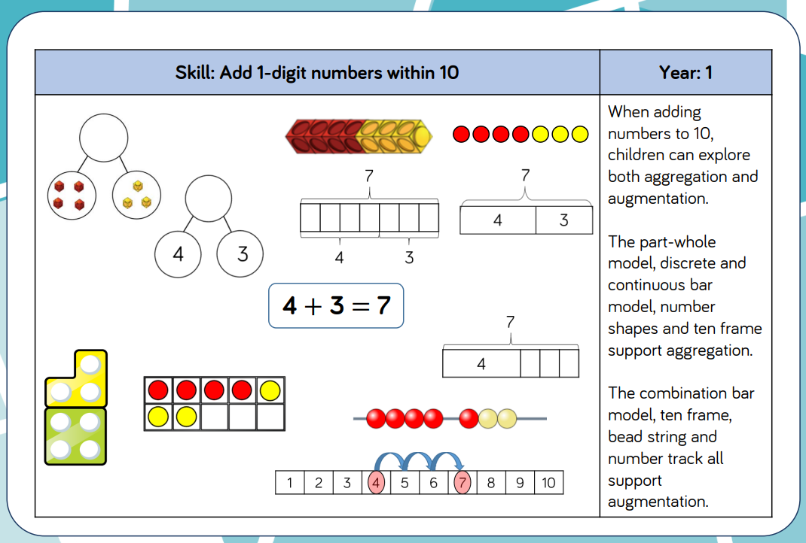
Example of how the representations are used

Slide 26
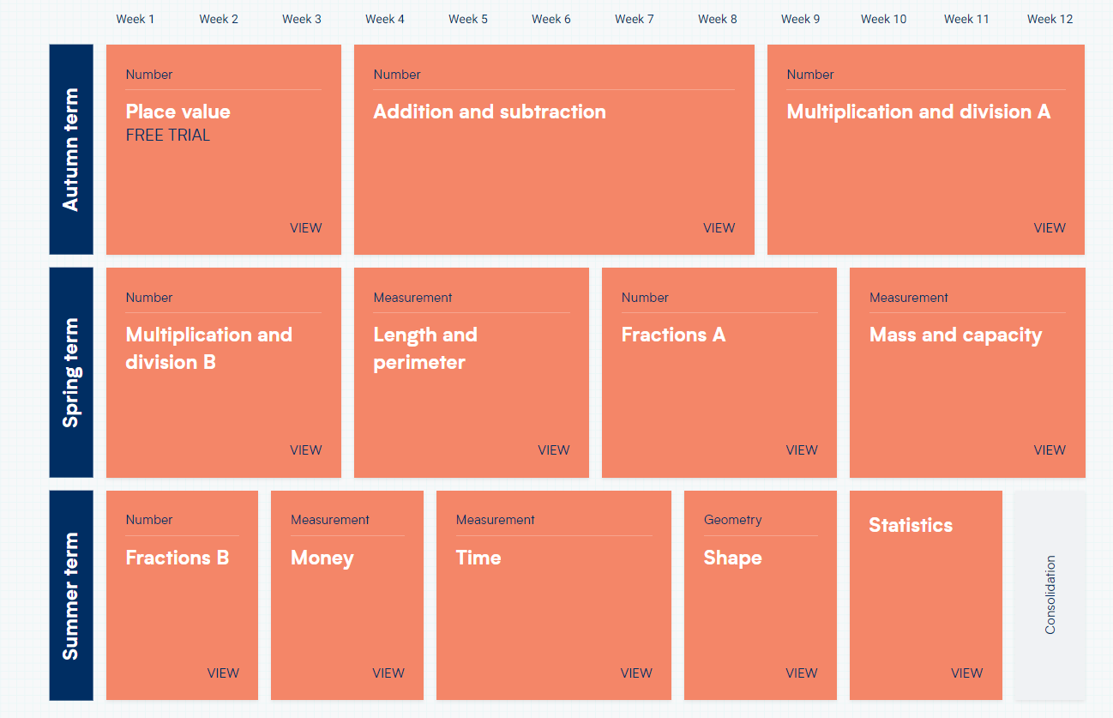
Example yearly overview

Slide 27
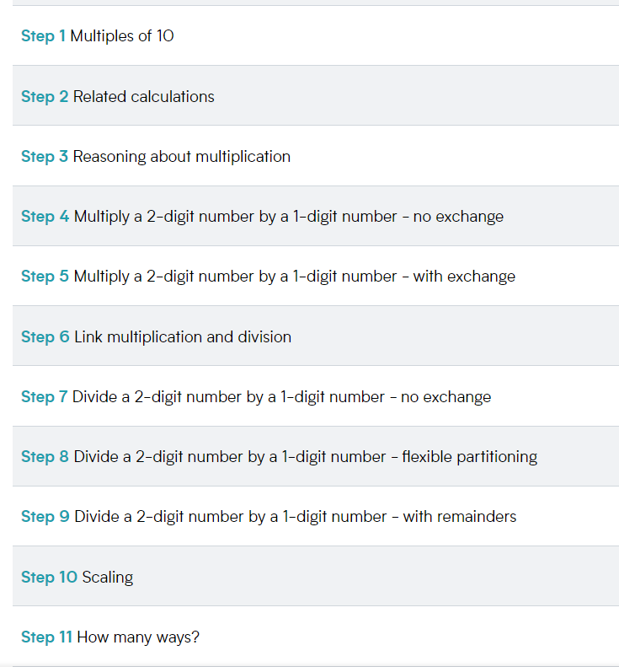
Example of a White Rose unit
Each unit is broken down into small steps
One step could be one lesson, two lessons or half a lesson
The teacher decides, using knowledge of their children, how to progress through these steps

Slide 28
What does a lesson look like?
Flashback 4
Teacher input – using a PowerPoint which is adapted to meet the needs of their individual class
Reasoning and problem solving questions
Independent work
An opportunity to respond to feedback. This can take many forms including in a small group, 1:1, making corrections independently or a whole class revisiting learning together.
Older children may mark their work within the lesson to gain instant feedback
Those who need it such as SEN and lower-attaining pupils may receive pre-teaching opportunities to support their learning.

Slide 29
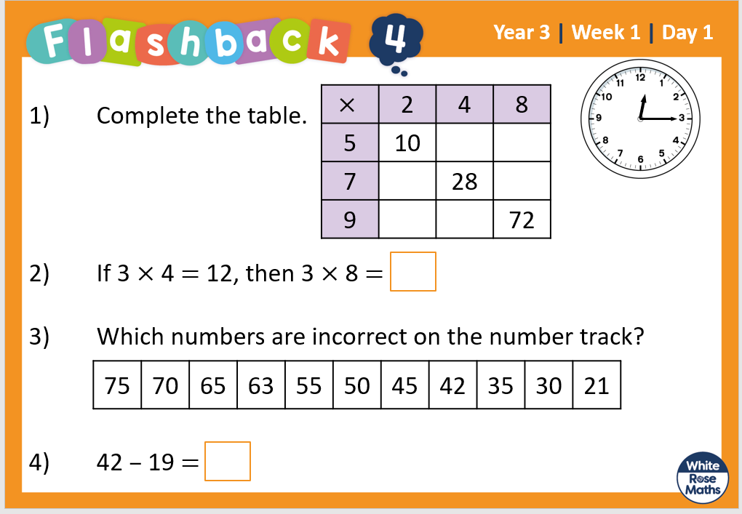

Slide 30
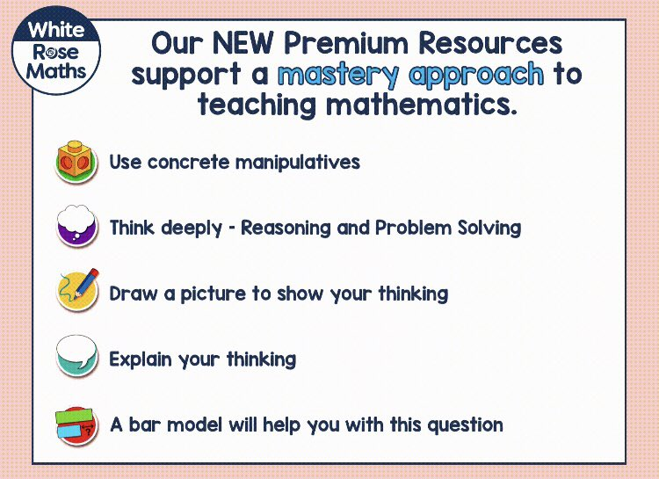
Example questions for the children
Y3 Spring Block 1 WO1 Multiples of 10.pdf (whiteroseeducation.com)
Teachers will pick and choose which questions are most relevant for their current cohort
Different question types:

Slide 31
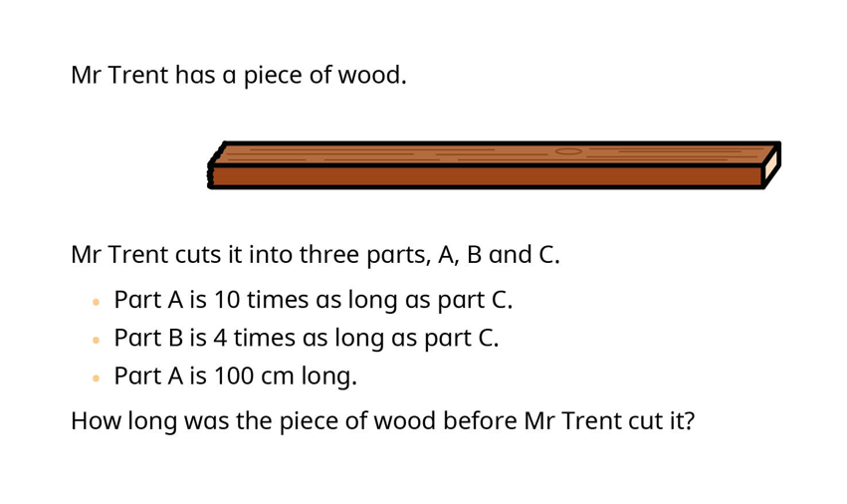
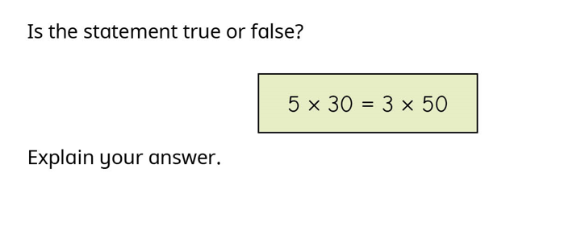
Reasoning and Problem Solving

Slide 32
Resources
Calculation policy indicates which strategies will be taught in each year group and which resources adults will teach the children to use in each year group.
Each class has a set of maths resources packs which are put on to tables for every maths lesson. Children can access these as and when they need to and they can choose which resource they find most helpful for the task.
We are aiming for independence and high achievement for all.

Slide 33
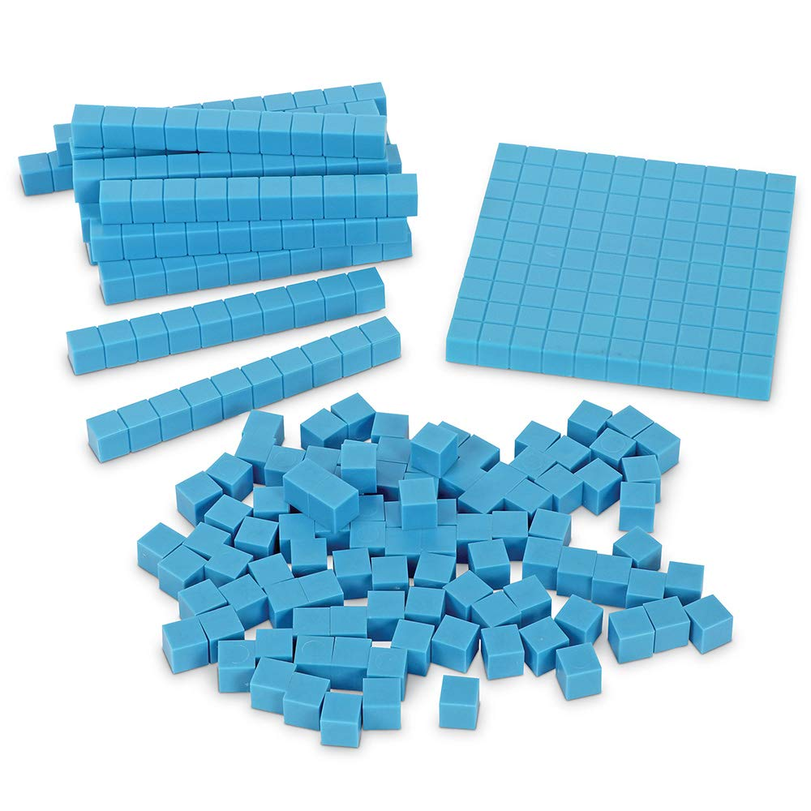
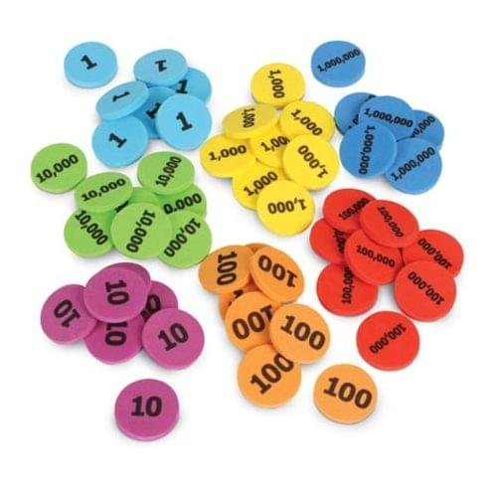
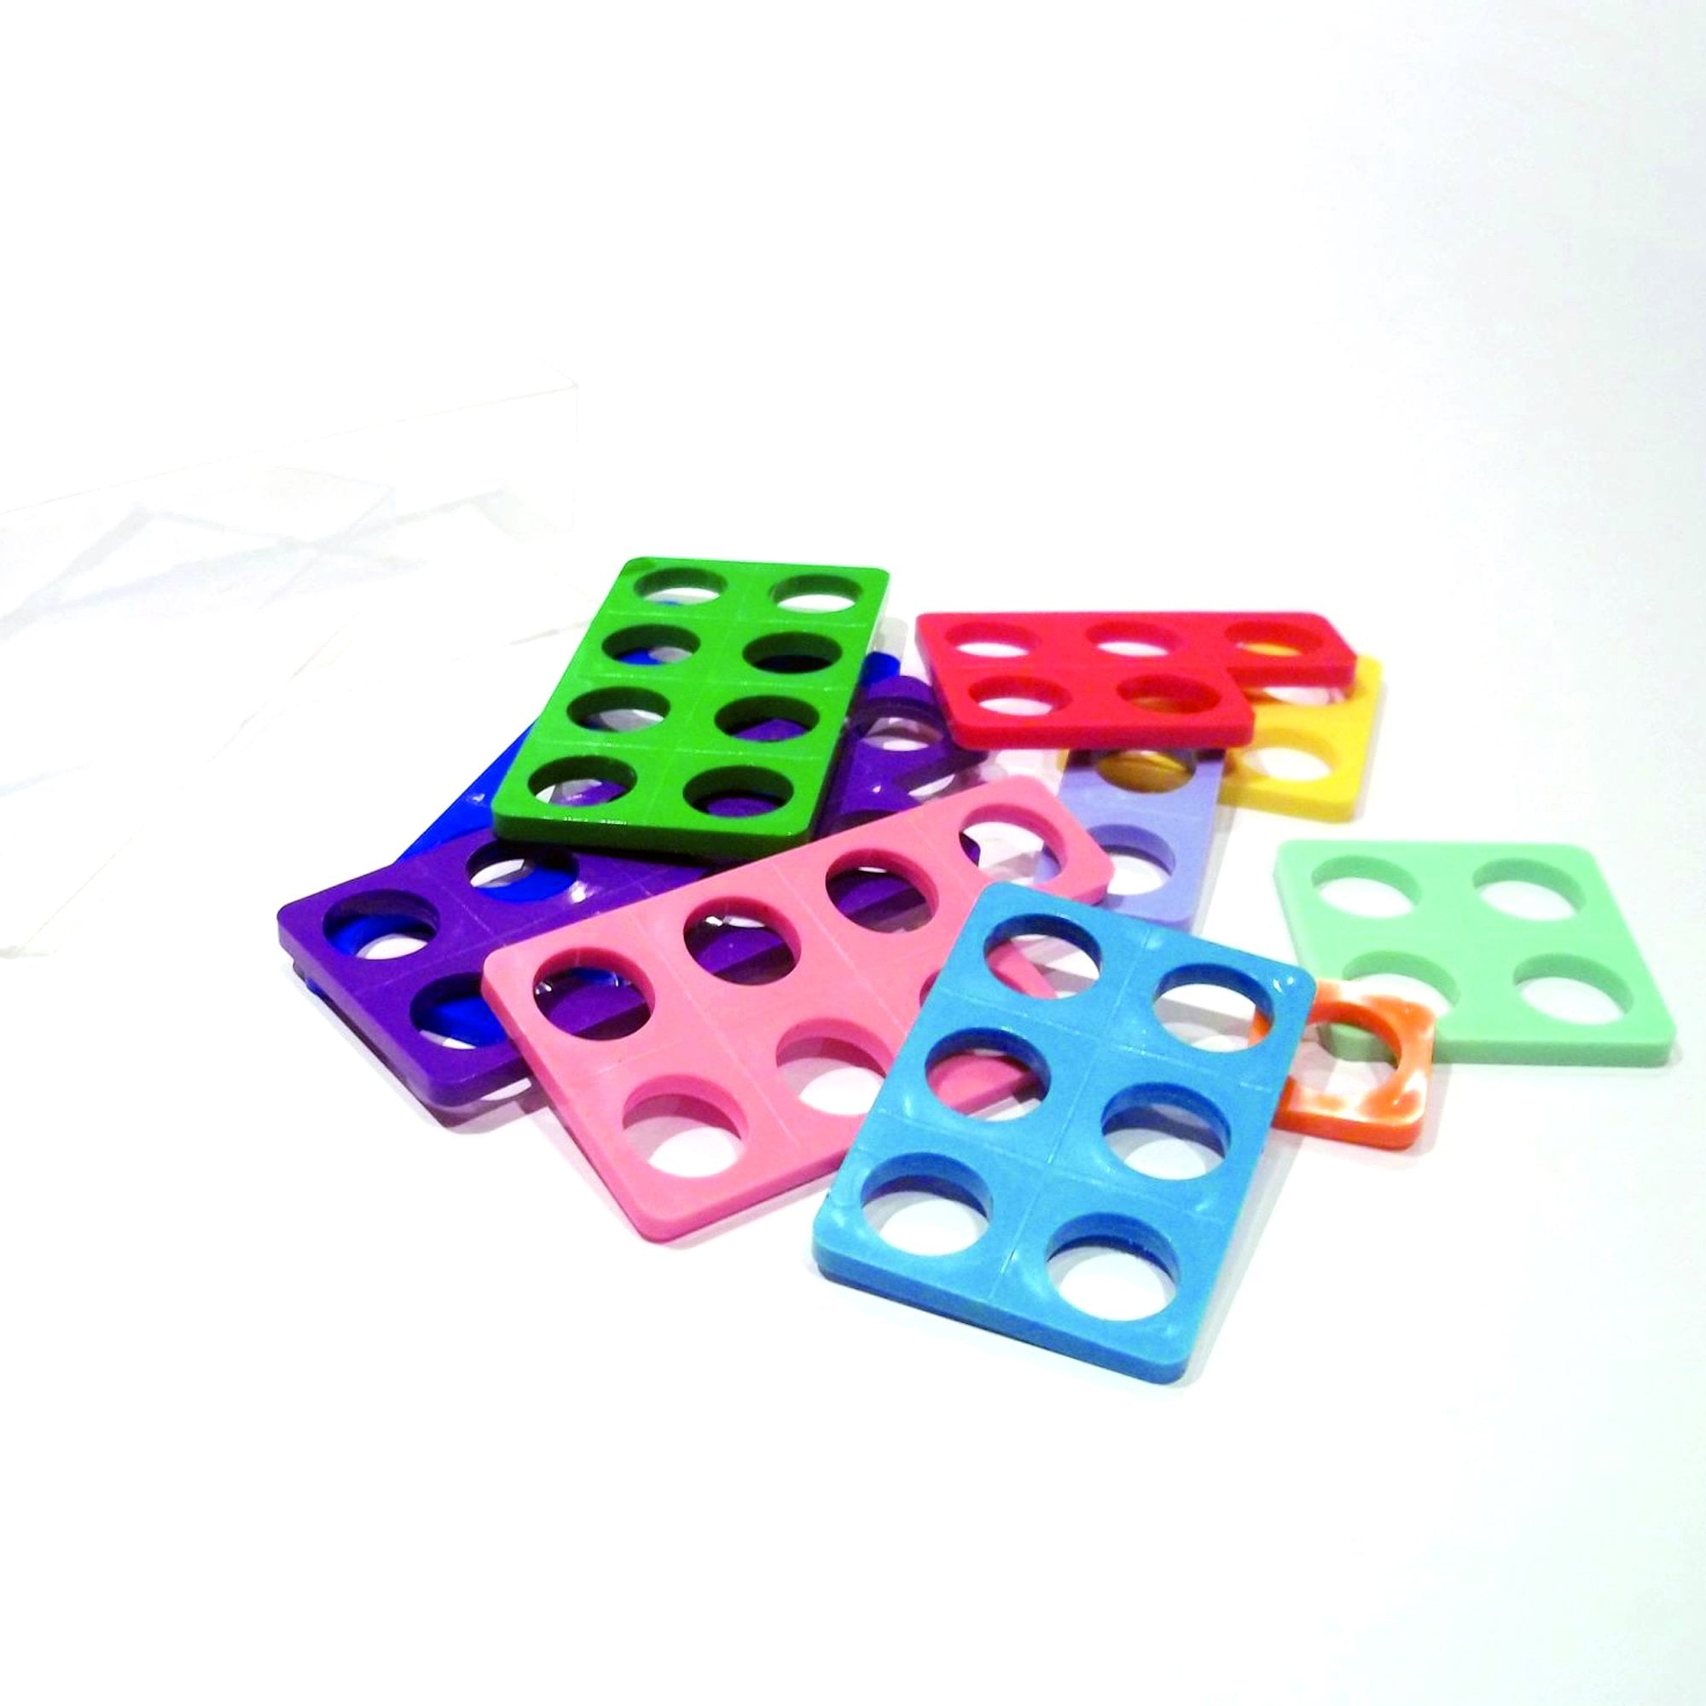
A closer look at resources …
Base 10
Composition
Addition/Subtraction – exchanging
Multiplication and division – exchanging
Understanding place value
Place Value Counters
Composition
Addition/Subtraction – exchanging
Multiplication and division – exchanging
Understanding place value
Numicon
Composition
Number bonds
Weighted
Odds/evens

Slide 34
Let’s have a go!
How many ways can you find to make the number 5?
Is it the same or different to someone else on your table?
Can you explain what is the same or different about the ways you have made the number 5?

Slide 35
ADD 2-DIGIT NUMBERS (ACROSS A 10)

Slide 36


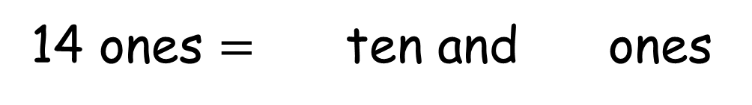
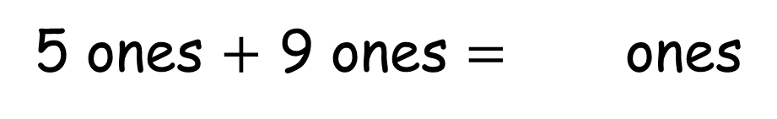

Dora is using base 10 to add numbers.
$+$
Dora
Complete the sentences.
5 ones $+$ 9 ones $=$ ones
14
14 ones $=$ ten and ones
1
4
Have a think

Slide 37

Complete the sentence.
16
ones $=$ ten and ones
1
6
How do you know when to exchange?
Have a think

Slide 38

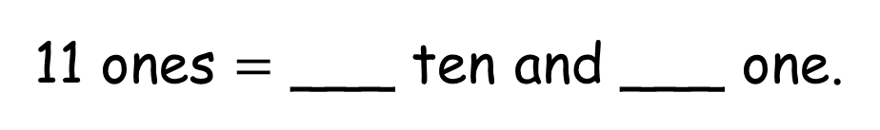


Here are two numbers in base 10
There are ___ ones altogether.
11
11 ones $=$ ___ ten and ___ one.
1
1
3 tens $+$ 2 tens $=$ ___ tens.
5
5 tens $+$ 1 ten $=$ ___ tens.
6
There are ___ tens altogether.
6
6 tens and 1 one is ___
61
35 $+$ 26 $=$
61

Slide 39


Use base 10 to calculate 45 $+$37
T | O
Do I need to make an exchange?
2
There are __ tens and __ ones.
8
Have a think
45 $+$ 37 $=$
82

Slide 40

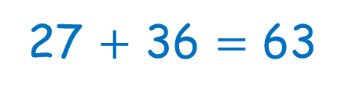


Tiny is calculating 27 $+$ 36
27 $+$ 36 $=$ 63
T | O
There are 5 tens and 13 ones. 27 $+$ 36 $=$513
Do you agree with Tiny?
Have a think
No – Tiny needs to exchange.

Slide 41
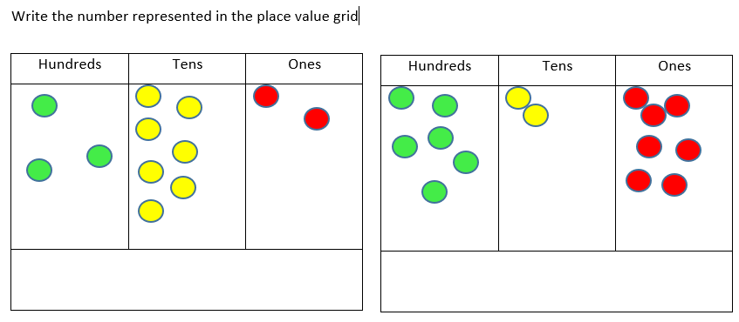
Let’s have a go!

Slide 42
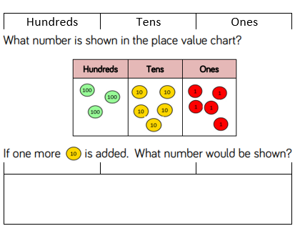
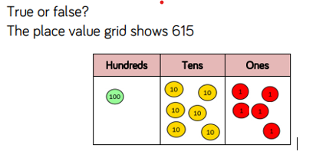
Let’s have a go!

Slide 43

Enriching mathematics for all learners.
To match the aims of the National Curriculum, Nrich believe that successful mathematicians understand curriculum concepts and are fluent in mathematical skills and procedures, and can also solve problems, explain and justify their thinking, and have a positive attitude towards mathematics and to themselves as learners of mathematics.
With this in mind, they provide rich mathematical activities which aim to nurture curious, resourceful and confident learners of mathematics and sit alongside our Maths curriculum and delivery with White Rose.
Let’s look at an example activity together.
https://nrich.maths.org/parents/primary
https://nrich.maths.org/parents/early-years

Slide 44
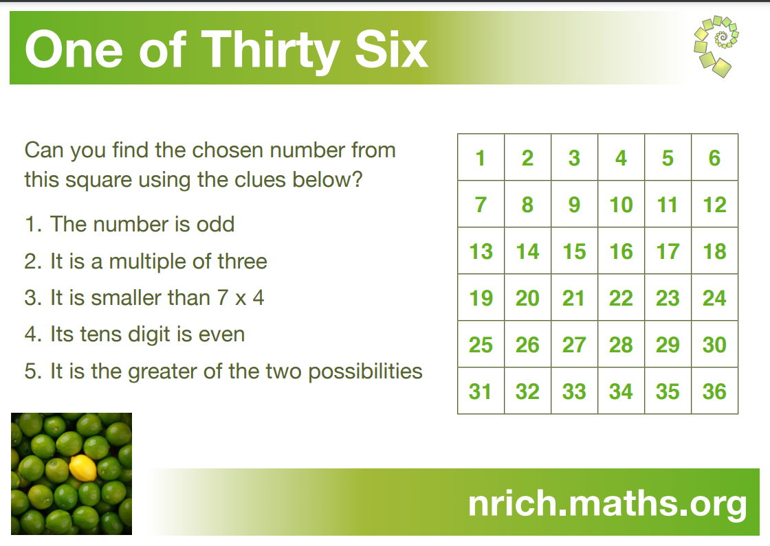

Slide 45
Mental maths
Mastering number for EYFS and KS1 develops children’s mental maths skills
In KS2 teachers seek opportunities to develop and rehearse the children’s mental maths skills through activities such as ‘hit the button’, singing songs and quick fire questions during daily routines
Ed Shed – teachers set tasks linking to the learning which has taken place during the week or they may choose to set mental maths challenges such as times tables. These mental maths challenges can also be accessed without being set by a teacher should your child wish to do some extra practise.

Slide 46
Multiplication tables check – Year 4
2024 multiplication tables check: information for parents (publishing.service.gov.uk)
Children answer 25 questions
6 seconds to answer each question before the test automatically moves on (3 second break between each question)
Children must input their answers into a laptop/tablet independently
Multiplication facts only (no division)
The DfE have not issued an official ‘pass mark’
It will be automatically scored and results will be available to schools at the end of the 2-week assessment period
Multiplication Tables Check - 2023 - Timestables.co.uk

Slide 47
How can we support children to prepare for the MTC?
At School
In years 3 and 4 the children will have regular practise of completing timed times tables tests in preparation for the official check in the summer term of Year 4
Year 1–Count in multiples of 2, 5 and 10
Year 2– Learn their x2, x5 and x 10
Year 3– Learn their x3, x4 and x8
Year 4– x6, x7, x9, x11, x12
Ed shed can be used as a rehearsal tool at home
At home
Climb stairs counting in multiples
Play verbal times tables games
Listen to and learn times tables songs
Play online maths games (such as EdShed)
Games such as snap, matching card games (lots available on the internet)
Remember –If your child is practising regularly at home, they are practising for the benefit of their wider maths education.

Slide 48
Why are times tables important?
Creating familiarity with times tables in the pivotal early stages of a child’s academic life will prevent maths from becoming a hated subject for them in future.
Having a secure grasp of the basics of maths, including the fluent recall of times tables, is crucial for children’s success in moving on to more complex maths.
The National Curriculum expectations are that children know their times tables up to 12 x 12 by the end of Year 4.
What is the purpose of the multiplication check?
To determine whether year 4 pupils can fluently recall their multiplication tables and are meeting the expected standard for their year group before moving to Upper Key Stage 2 (Year 5 and Year 6)
Identify children who may need additional support, so they can access the demands of the Y5 and Y6 maths curriculum with success.

Slide 49
Additional support and strategies for those who need it
Intervention groups
Partner work
Adult support
Resources
5 bs – brain, board, book, buddy, boss

Slide 50
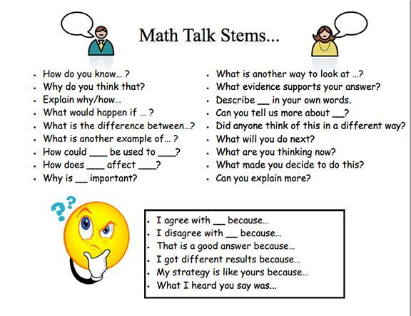
How can you help your child at home?
Help with learning key number facts (number bonds, times tables etc.)
Encourage daily practice of fluency/number facts
Questioning rather than telling the answer- use talk stems to help discussion

Slide 51
Useful documents/resources
Our calculation policies
White Rose Maths app
Hit the Button https://www.topmarks.co.uk/maths-games/hit-the-button
Maths Shed https://www.mathshed.com/en-gb/
White Rose Parent Support https://whiterosemaths.com/advice-and-guidance

